Slide 1


Social Buzz
- Insight

Slide 2


Today's agenda
Project recap
Problem
The Analytics team
Process
Insights
Summary

Slide 3

Project Recap

Slide 4
Project Recap
The Social Buzz who is the social media content creator company stated that scale was a big problem of theirs and they are struggling to manage the scale with the resources that they currently have. The brief said that the client is looking for help with the management of their journey into such a large scale.
Social Buzz Expecting Three requirements, they are
Audit of big data practice,
Recommendations for IPO,
Analysis of popular content

Slide 5

Problem

Slide 6
Problem
The Social Buzz who is the social media content creator company stated that scale was a big problem of theirs and they are struggling to manage the scale with the resources that they currently have. More than 100000 post per day. Thus, they need to find most popular post.

Slide 7



The Analytics team

Slide 8
Analytics Team
Managing Director – Mae Mullingan
Chief Technology Architect – Andrew Fleming
Senior Principal – Marcus Rompton
Data Analyst – Kavinilavan Muthukumar

Slide 9
Process
1
2
3
4
5

Slide 10
Process
Analysis of sample data sets with visualizations to understand the popularity of different content categories. So, the following process are helps us to find the popularity content
Data Gathering ( includes Content, Relations, Relations Table)
Data Cleaning (accuracy, completeness, reliability, relevance, and timeliness)
Data Modelling ( connecting three data using relevant feature)
-Data Visualization (in Power BI)
- Interpretation

Slide 11

Insights

Slide 12
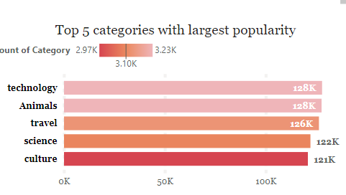
Key Findings
What is the top 5 categories by popularity ?

Slide 13
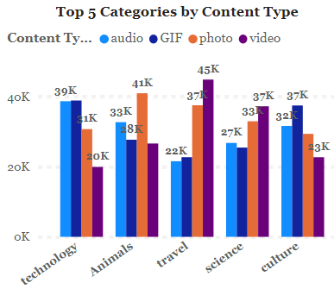
Key Finding
What is the top 5 categories by Content Types?

Slide 14
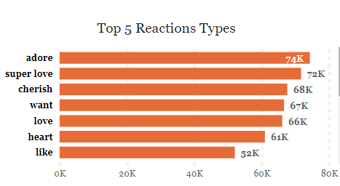
What is the Highest Reaction Types by popularity score ?

Slide 15
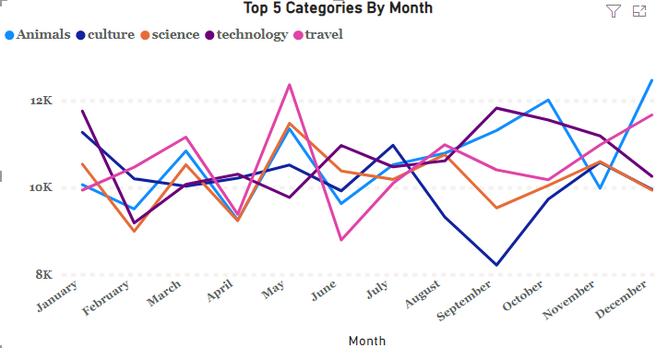
Key Finding
Top 5 Categories By Month?

Slide 16
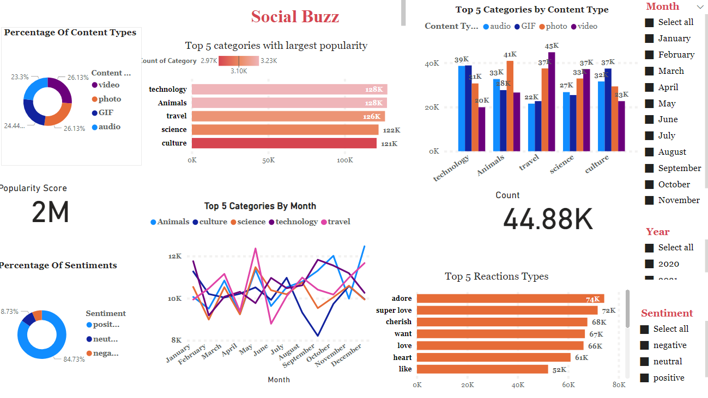

Slide 17

Summary

Slide 18
Summary
The top 5 categories by largest popularity is Technology, animals, travel followed by science and culture. The popularity score of technology and animals is 128k each and Travel popularity score is 126k. The science and culture popularity score is 122k and 121k respectively.
Top 5 categories by content types – content type video has a popularity score of 45k in Travel. Content type photo has a popularity score of 41k in animals. 39k gif in technology. Finally, 39k audio in technology. Overall, in technology, audio and gif are highest score. And, travel, photo and video is highest.
3) Top 5 reaction types – adore, super love, cherish are highest followed by want, heart and love.
4) Top 5 categories by month- Technology has highest score in September and January, and lowest in the month between February.
Travel has highest score in may and lowest in July.
Culture has lowest score in between September to October and highest in July
Note: travel is lowest in July
Culture has lowest in September and highest in January

Slide 19
Summary
5) Percentage of content type – four content type( Video, photo, gif, audio) score is equally distributed
6) Positive sentiment is occurred more often.

Slide 20
Thank you!
ANY QUESTIONS?

